Slide 1
Aerial Image Analysis for Smart City Development

Slide 2
"Smart Cities, Sick Streets?"
Urban littering, stagnant rooftop tanks, and polluted waterbodies significantly contribute to the spread of vector-borne diseases in densely populated cities. These conditions directly undermine public health, increase disease outbreaks (e.g., dengue, malaria), and strain healthcare systems. As a result, resources that should be invested in innovation, infrastructure, and sustainability are redirected to managing preventable health crises. Moreover, these issues erode public trust and hinder data-driven urban planning, making it difficult to achieve the core objectives of a smart city—efficiency, safety, and a high quality of life. Addressing these problems is essential to building truly resilient, healthy urban environments.

Slide 3
STRATEGY TO HANDLE
Traditional monitoring methods are labor-intensive and lack scalability. To address this, we leverage high-resolution drone imagery and computer vision-based annotation techniques to automatically detect and classify public health risks. This data-driven approach enables proactive health monitoring and supports smarter, more resilient urban development strategies. To built a model we need annotated images so that model can be trained using that images and then by itself detect it on new images .

Slide 4
Docker software is used as it allows each container to run independently and each containers are lightweight and start fast.
I had started my project using cvat annotation tool but since it is a heavy duty tool and it includes 10-12 dockers running in parallel and it’s an efficient tool for long video as well as images but my machine system crashed frequently so I decided to switch on to Label Studio which is a light weight tool but heavly efficient to annotate the images.

Slide 5
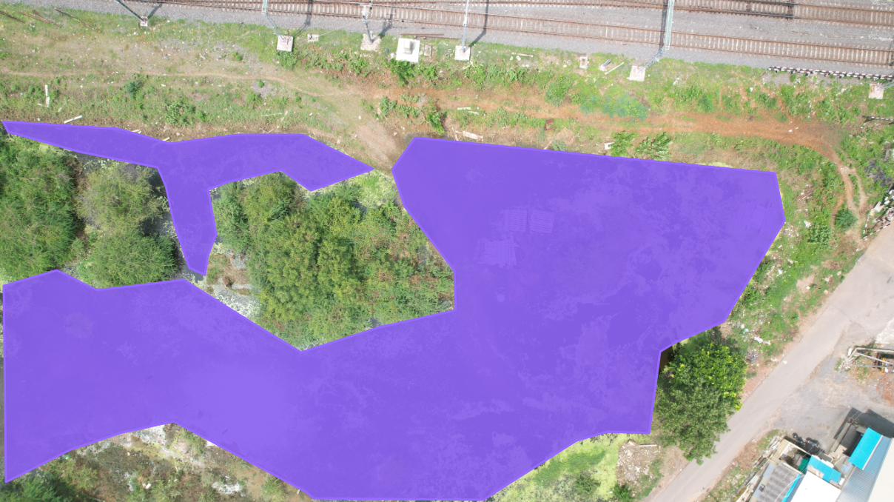
Waterbody Annotation

Slide 6
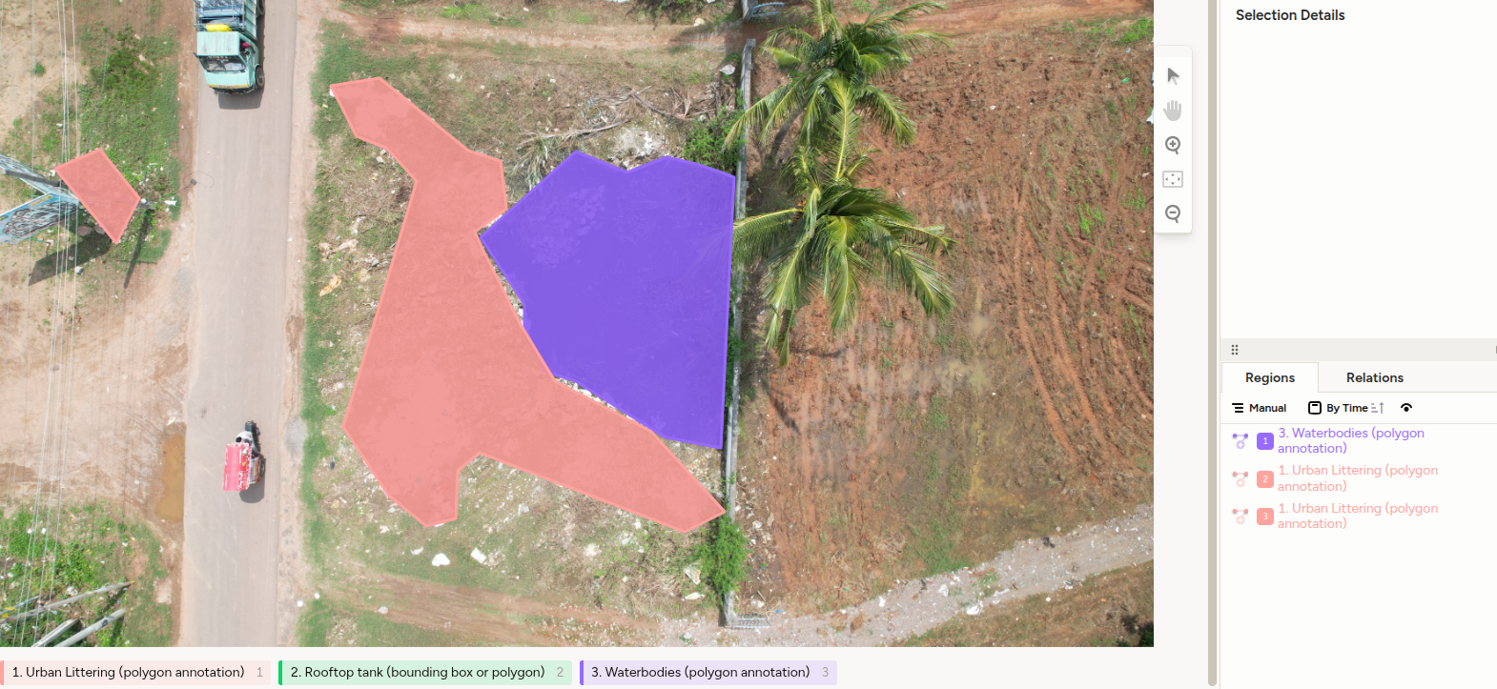
Urban Littering Annotation

Slide 7
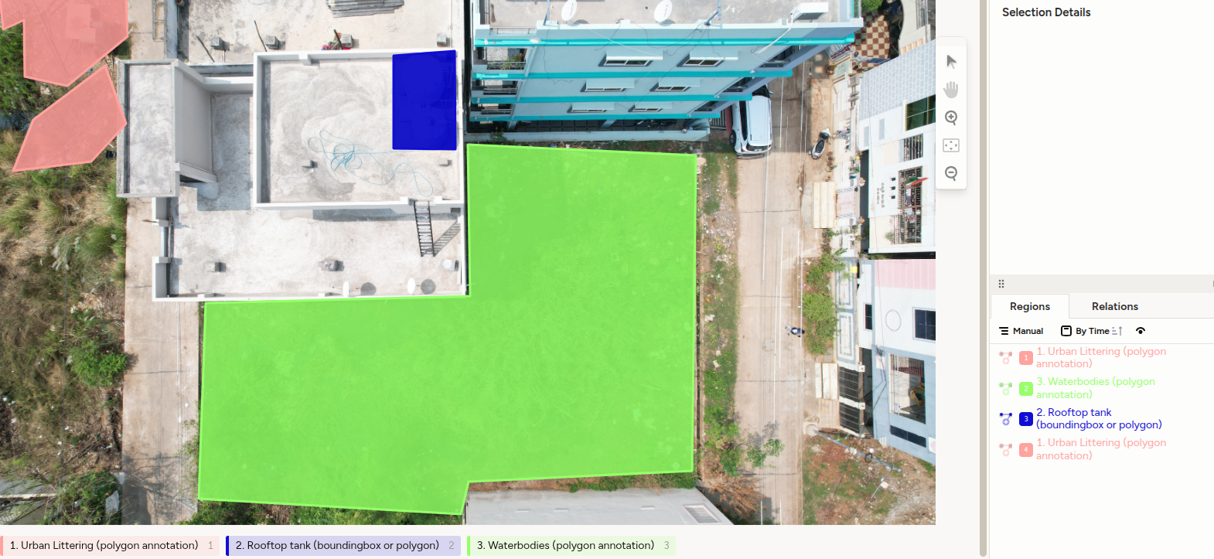
Rooftop Tank Annotation

Slide 8
I have also written a utility code to overlay the annotation in the original image. To manage large scale annotation such codes help to annotate the images.

